Slide 1
Business Process Engineering
Week 07-08

Slide 2
Business-to-Business Processes
Enterprise Services Computing
A service captures functionality with a business value that is ready to be used.
Services are made available by service providers.
A service requires a service description that can be accessed and understood by potential service requestors.
Software services are services that are realized by software systems.
Consider a real-world service, for example, one to fix a car. The service the garage provides needs to be specified in a way that the customer can find and use. Once the car is fixed, the customer pays the bill and the service is completed.

Slide 3
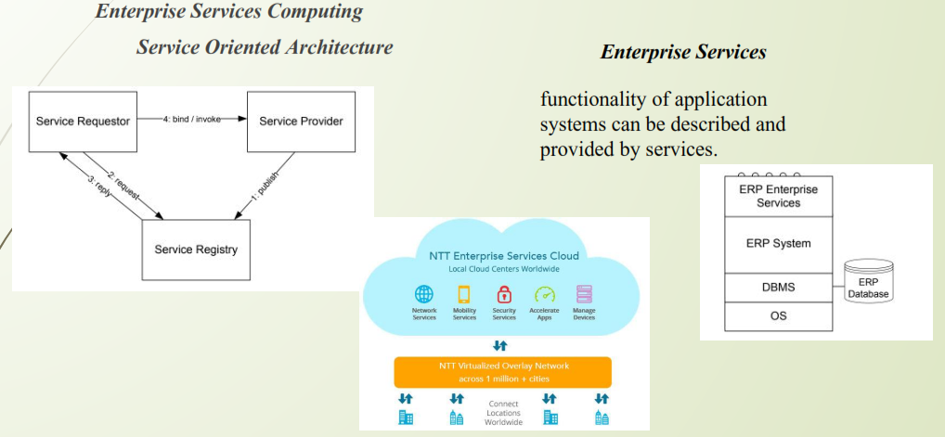
Business-to-Business Processes

Slide 4
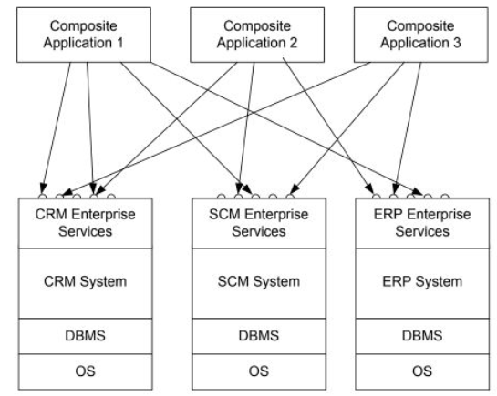
Composite Application
With this background in enterprise services architectures, an intra-company
scenario is sketched, where new applications should be built on top of an existing customer relationship management system, a supply chain management system, and an enterprise resource planning system. These systems expose enterprise services via standardized interfaces. The applications built on top are known as composite applications,

Slide 5
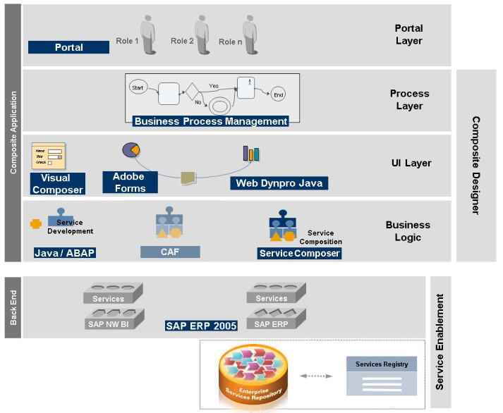

Slide 6
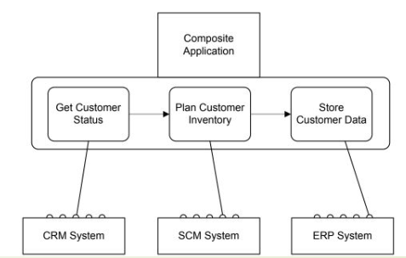
Service Composition
Using service composition to realize composite applications

Slide 7
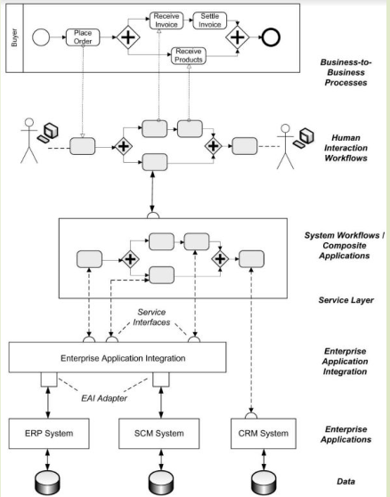
Business process management landscape
Workflow Management Coalition defines workflows and workflow management systems as follows.

Slide 8
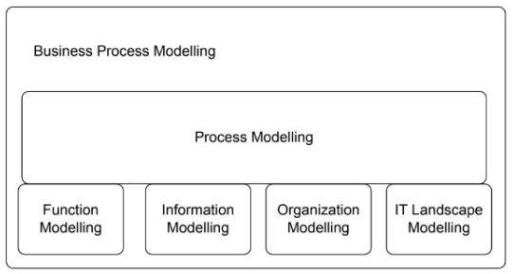
Business Process Modeling
Function modelling, data modelling, organization modelling, and modelling of the operational information technology landscape are required to provide a complete picture of a business process.

Slide 9
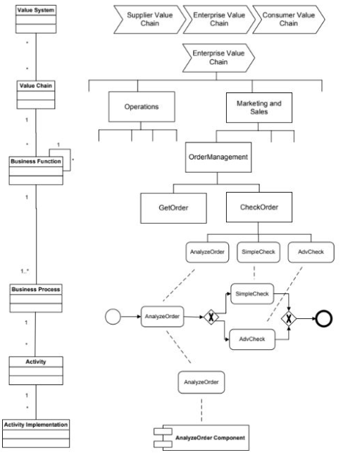


Slide 10
Conceptual Model:
Business processes consist of activities whose coordinated execution realizes some business goal. These activities can be:
1. system activities
2. user inter-action activities
3. manual activities.

Slide 11
Conceptual Model
1. Manual Activity
manual activity is sending a parcel to a business partner. Manual activities are not supported by information systems.
2. User Interaction Activity
human interaction activity is entering data on an insurance claim in a call center environment. There is no physical activity involved.
3. System Activity
System activities do not involve a human user; they are executed by in-formation systems. An example of a system activity is retrieving stock in formation from a stock-broker application or checking the balance of a bank account.

Slide 12
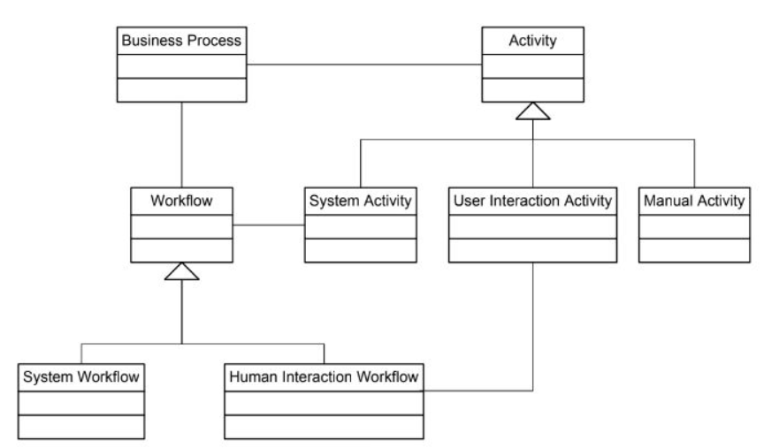

Slide 13
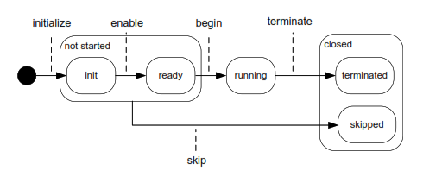

Slide 14
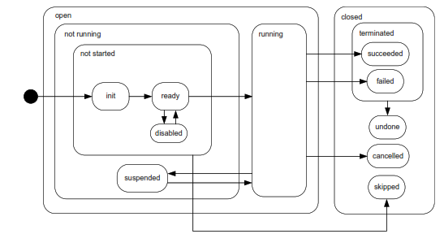

Slide 15
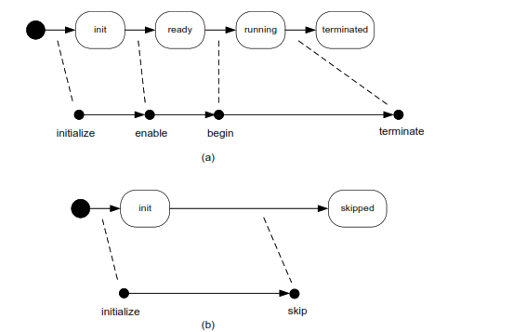

Slide 16
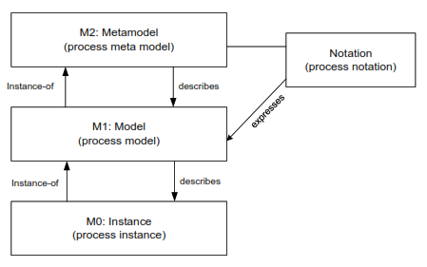
Process MetaModel
Business processes consist of a set of related activities whose coordinated execution contributes to the realization of a business function in a technical and organizational environment.
Business processes are represented by business process models.
Meta Object Facility (MOF) for the process
subdomain.

Slide 17
Process Models
Any modelling eﬀort starts with identifying the main concepts that need to be represented.
The following models are identiﬁed as concepts in the metamodel.
Process Model: A process model represents a blue-print for a set of process instances with a similar structure.
Consists of a set of activity models.
Nesting of process models within process models is not represented,
Each process model consists of nodes and directed edges

Slide 18
Process Models
Edge: Directed edges are used to express the relationships between nodes in a process model.
Node: A node in a process model can represent an activity model, an event model, or a gateway model.
Activity Models: Activity models describe units of work conducted in a business process. Each activity model has exactly one incoming edge and exactly one outgoing edge.
Event models: Event models capture the occurrence of states relevant for a business process. Process instances start and end with events, so process models start and end with event models.
Gateway Models: Gateways are used to express control ﬂow constructs, including sequences, as well as split and join nodes.

Slide 19
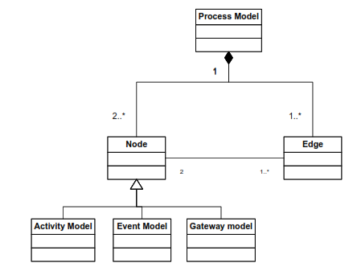

Slide 20
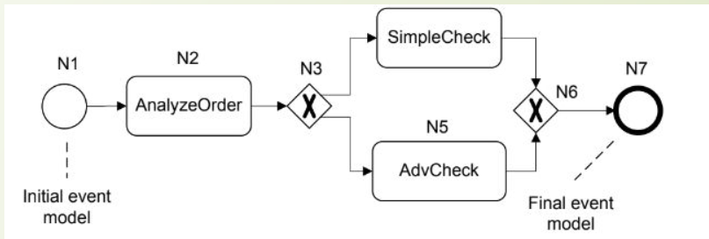
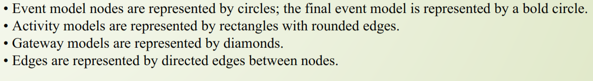

Slide 21
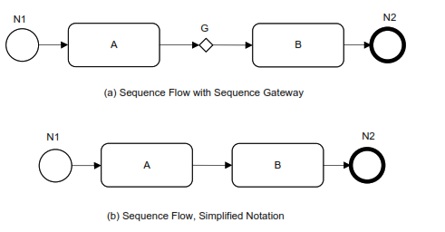
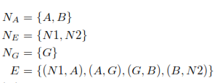
Let C be a set of control ﬂow constructs.
P = (N, E, type) is a process model if it consists of a set N of nodes, and a set E of edges.
• N = NA ∪ NE ∪ NG, where NA is a set of activity models, NE is a set of event models, and NG is a set of gateway models. These sets are mutually disjoint.

